Slide 1
A CAPSTONE PROJECT CAP328 PEER SUPPORT
TO
SCHOOL OF COMPUTER APPLICATION
IN PARTIAL FULFILLMENT OF THE
REQUIREMENT FOR THE
AWARD OF THE DEGREE
OF
BACHELOR OF COMPUTER APPLICATIONS
APRIL 2016
NEERAJ PRASAD GUPTA

Slide 2
PEER SUPPORT
(it is developed using HTML, CSS, JavaScript, PHP, and MYSQL)

Slide 3
ABSTRACT
The main objective of the project is to create a web application that allows users (students) to upload and download the study materials based on their need. The uploaded material will be displayed in the form of list and students can download these study material. Using the website, students can request the topics which they want from the other students or peers.
There are various management systems in different universities, colleges, and institutes where students can download the content uploaded by the faculties only. We want to develop a different a different website where students can download and upload the study materials for their peers.

Slide 4
Continue..
The Peer Support website provide uploading and downloading facilities through a web browser. A student can, register himself just for getting the uploaded files and he can also become the uploader after selecting the base topic.
The Administrator will have the additional functionalities when compared to the common user. He can view the registered students, their topics, uploaded files etc. He can also add new topics in topic list.

Slide 5
ADVANTAGE OF WEBSITE
STUDENT MODULE
Registration form for online study material.
Login their account.
View student homepage.
Download study material.
Request study material.
Edit and delete study material.
Feedback.
Discussion.
Logout

Slide 6
Continue..
UPLOADER MODULE
Registration form to upload study material.
Login their account.
View uploader homepage.
Upload study material.
Download study material.
Add and withdraw topic.
Feedback.
Discussion.
Logout.

Slide 7
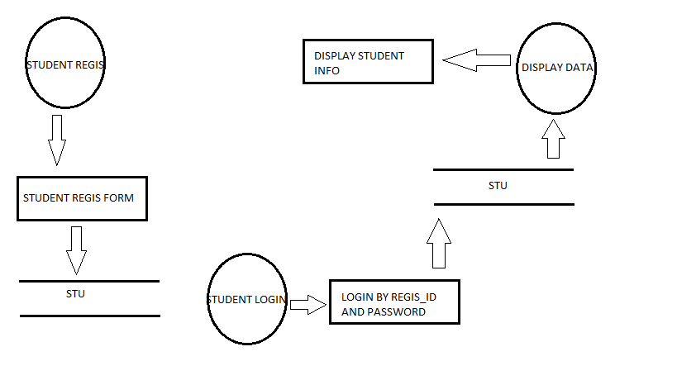
DFD OF STUDENT REGISTRATION AND LOGIN.

Slide 8
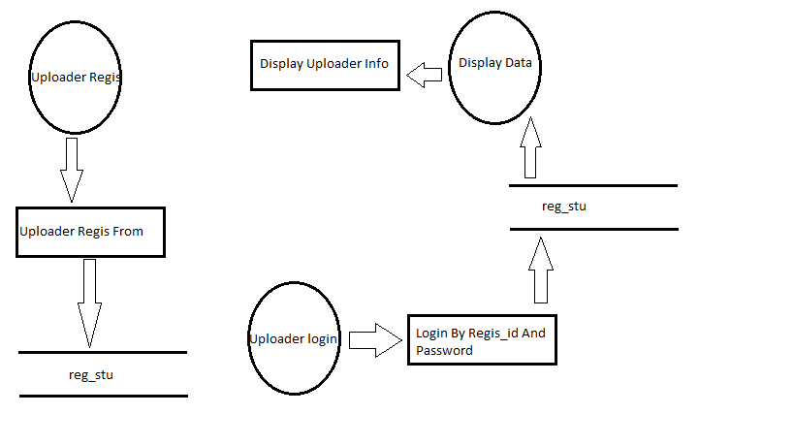
DFD OF UPLOADER REGISTRATION AND LOGIN.

Slide 9
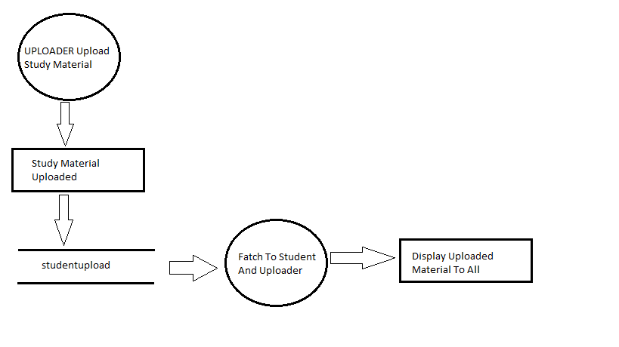
DFD TO UPLOAD STUDY MATERIAL.

Slide 10
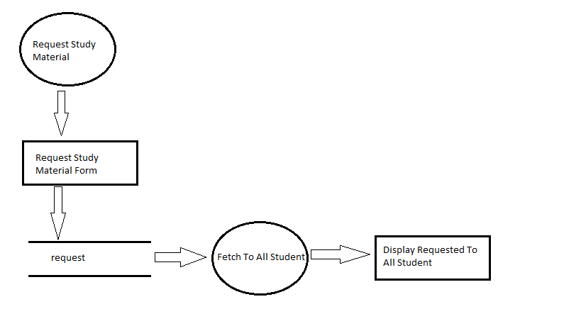
DFD OF REQUEST STUDY MATERAIL BY STUDENT.

Slide 11
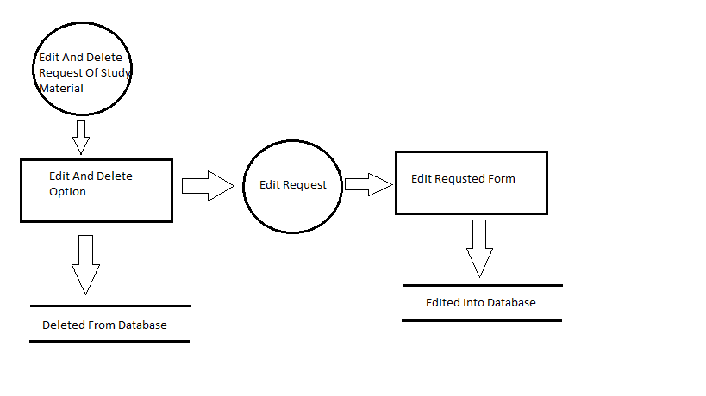
DFD OF EDIT AND DELETE REQUEST.

Slide 12
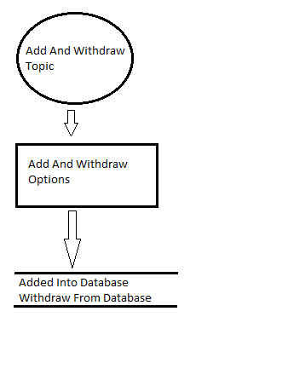
DFD OF ADD TOPIC AND WITHDRAW TOPIC BY UPLOADER.

Slide 13
THANKS

